Slide 1
Climate policies and regulations: impact on the port sector
Bogdan Ołdakowski, Secretary General of Baltic Ports Organization
Julia Kosiek, Project Assistant, Actia Forum
15/12/2021

Slide 2
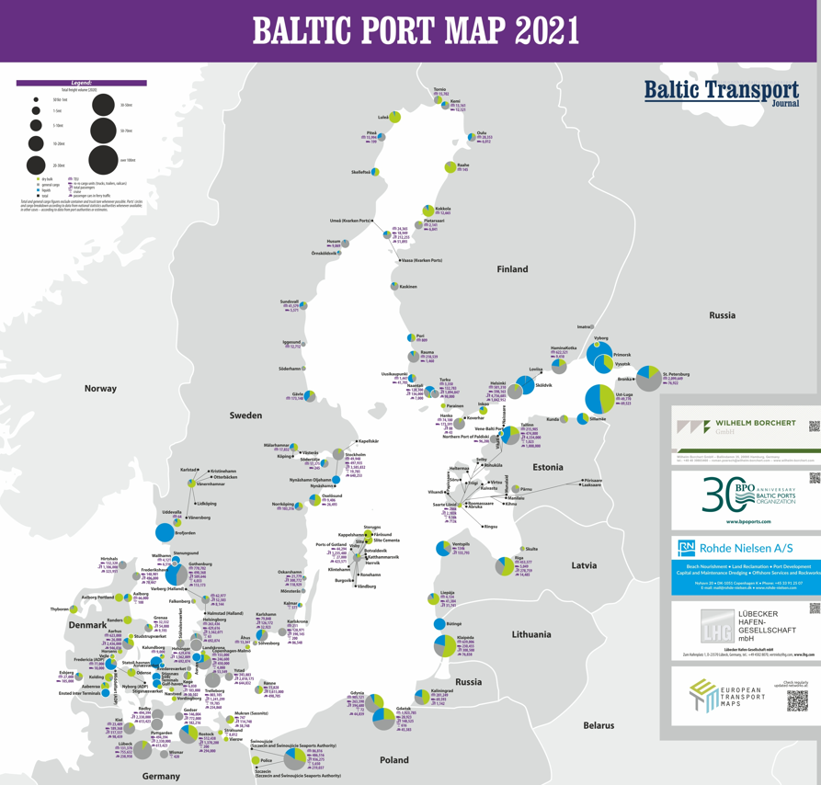
Will climate policies change the port sector?

Slide 3
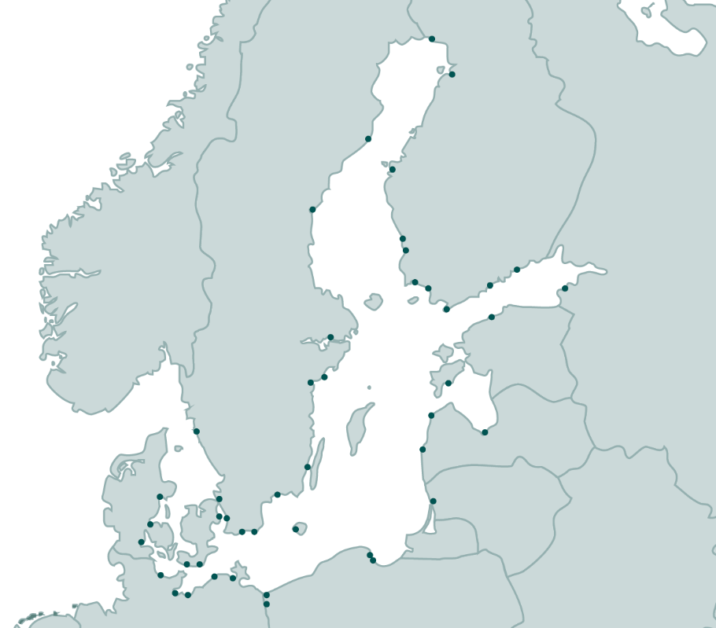
BPO in a nutshell
BPO – Baltic Ports Organization
—
established
October 10, 1991
Copenhagen
nearly 50 members
major ports in the 9 countries
registered in Estonia
Port of Tallinn headquarter
office in Gdynia
Poland

Slide 4
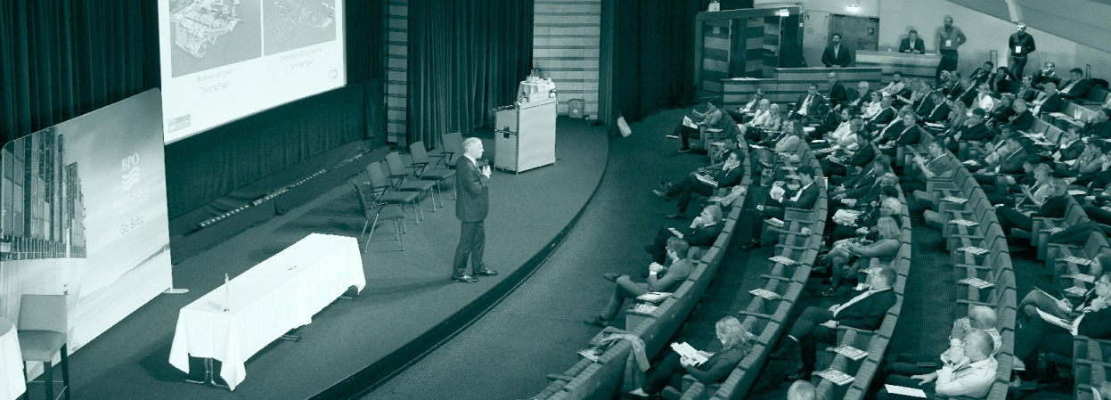
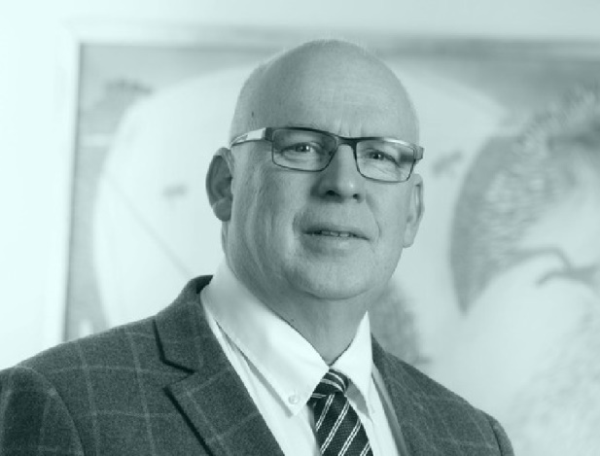
BPO in a nutshell
BPO’s mission
—
—
The BPO's mission is to contribute to sustainable development of maritime transport and the port industry in the Baltic Sea Region, thereby strengthening its global competitiveness.

Slide 5
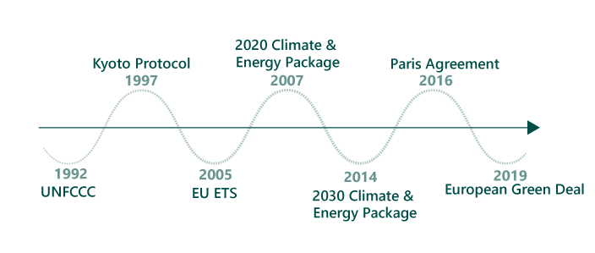
GHG emission reduction - international agreements and declarations
Timeline of international agreements and conventions concerning climate changes
—
Source: Actia Forum

Slide 6
European Green Deal - main GHG emission reduction targets
Become a resource-efficient and competitive economy where there are no net emissions of greenhouse gases in 2050.
„Fit for 55” - on 14 July 2021, the European Commission adopted a series of legislative proposals setting out how it intends to achieve climate neutrality in the EU by 2050, including the intermediate target of an at least 55% net reduction in greenhouse gas emissions by 2030.
—
Source: EU

Slide 7
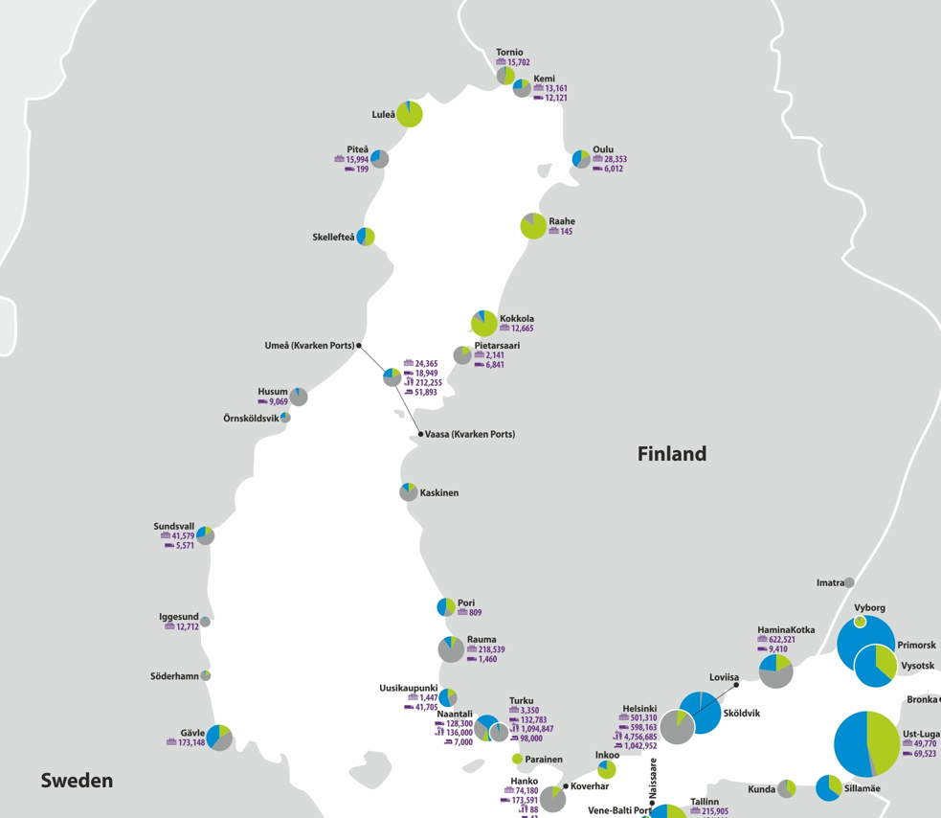
Expected changes in the industry- metal industry
H2 Green Steel to build large-scale fossil-free steel plant in northern Sweden
H2GS will be a large-scale steel producer based on a fossil-free manufacturing process targeting large European OEMs. H2GS will be located in the Boden-Luleå region in northern Sweden that offers unique conditions for fossil-free steel production. The project includes a giga-scale green hydrogen plant as an integrated part of the steel production facility. Production will begin in 2024 and by 2030, H2GS will have annual production capacity of five million tons of high-quality steel.
—
Source: H2 Green Steel

Slide 8
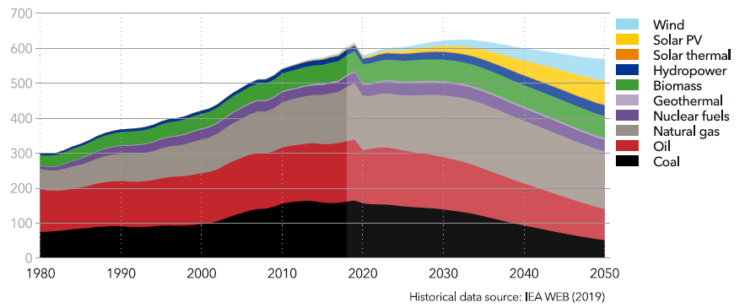
Future energy mix
World primary energy supply by source (EJ/year )
Electricity mix in Europe in 2050
—
Source: DNV

Slide 9
Fossil fuels in Baltic ports
Throughput of crude oil, oil products, coal&coke and liquid gases in the Baltic ports in 2005-2020 (thou. tonnes )
—
Source: Eurostat

Slide 10
Fossil fuels in Baltic ports
Throughput of coal&coke in ports in Baltic countries in 2005-2020 (thou. tonnes )
Throughput of crude oil in ports in Baltic countries in 2005-2020 (thou. tonnes )
—
Source: Eurostat

Slide 11
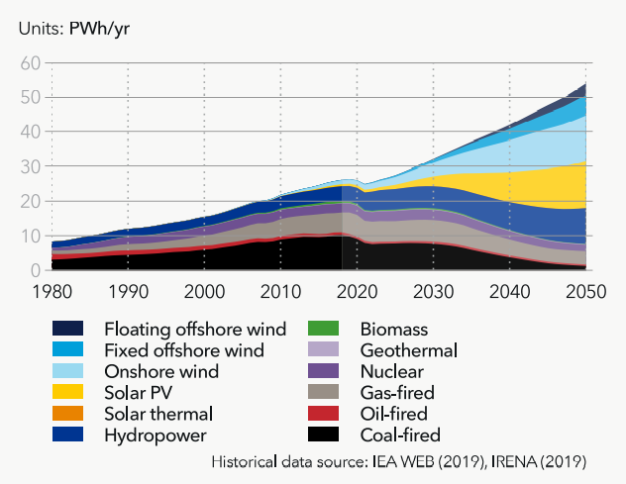
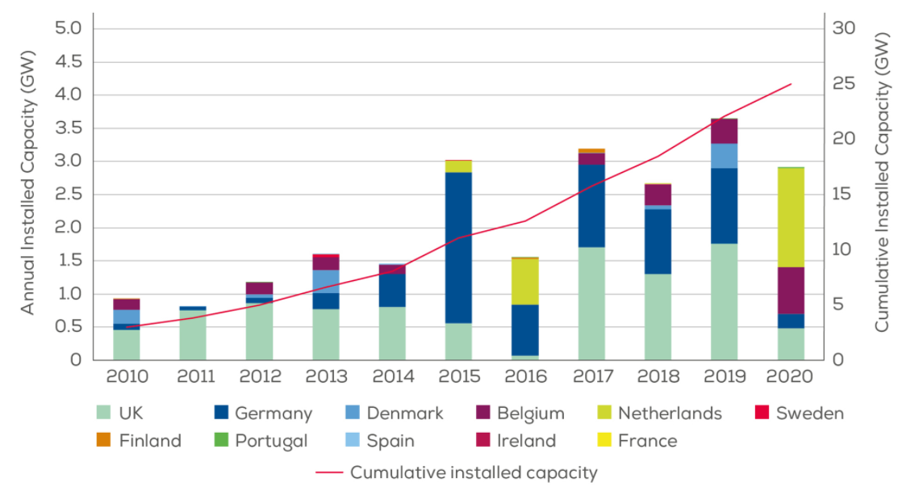
Ports as hubs for renewable energy
Annual offshore wind installations by country (left axis) and cumulative capacity (right axis)
World electricity generation by power station type
—
Source: DNV, Wind Europe

Slide 12
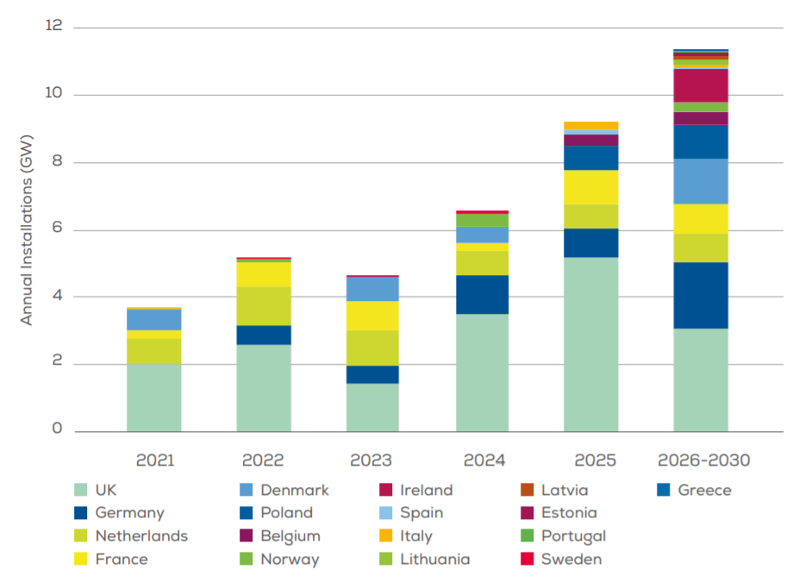
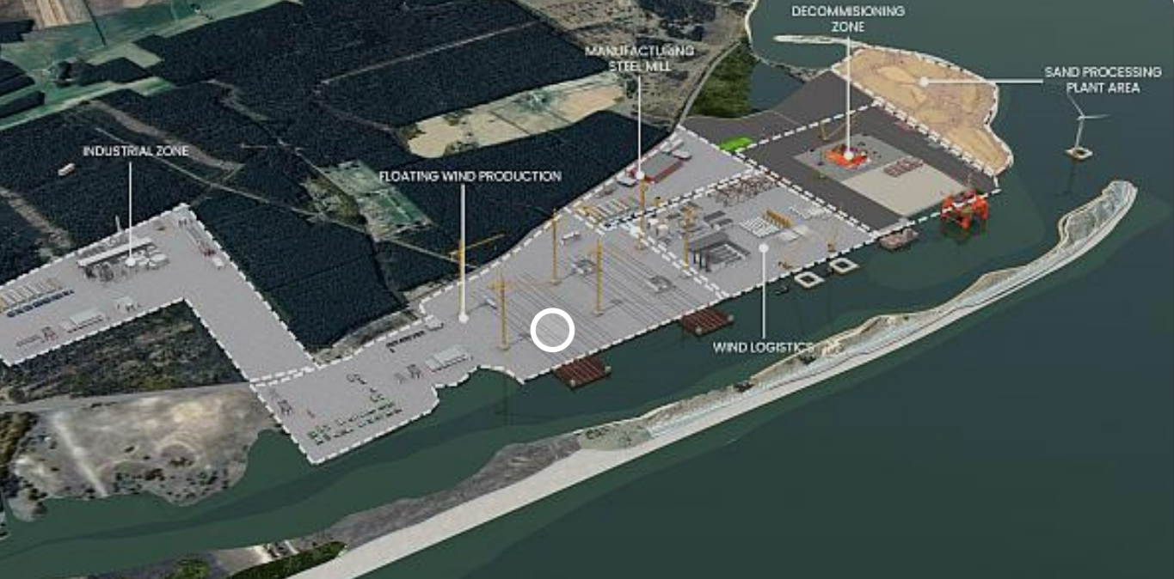
Ports as hubs for renewable energy
Annual offshore wind installations planned to 2030 by country
—
Source: Wind Europe, Port of Roenne

Slide 13
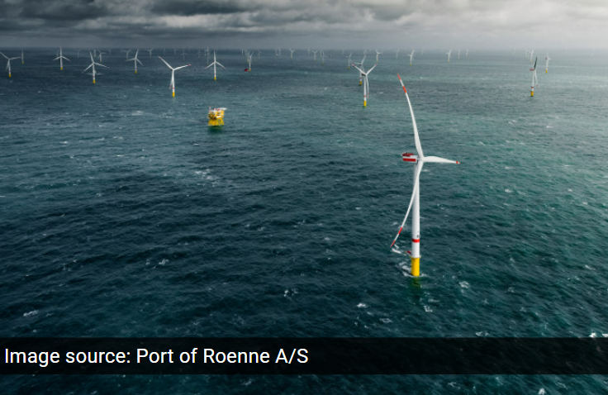
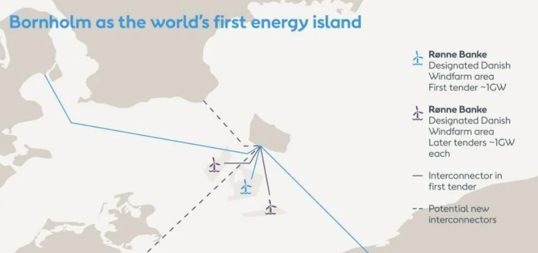
Ports as hubs for renewable energy
Offshore wind farm in Port of Roenne.
—
Source: Port of Roenne

Slide 14
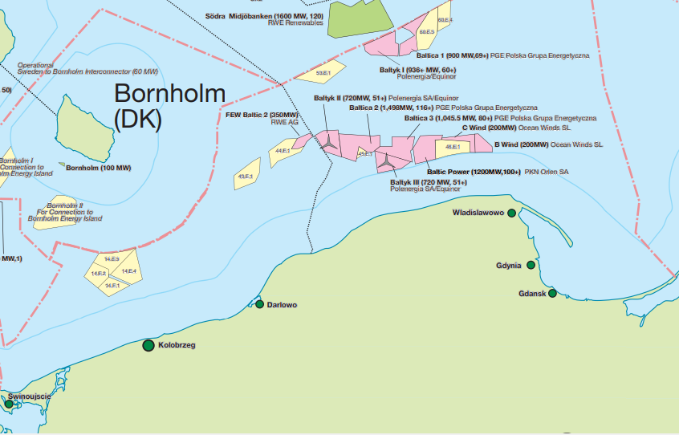
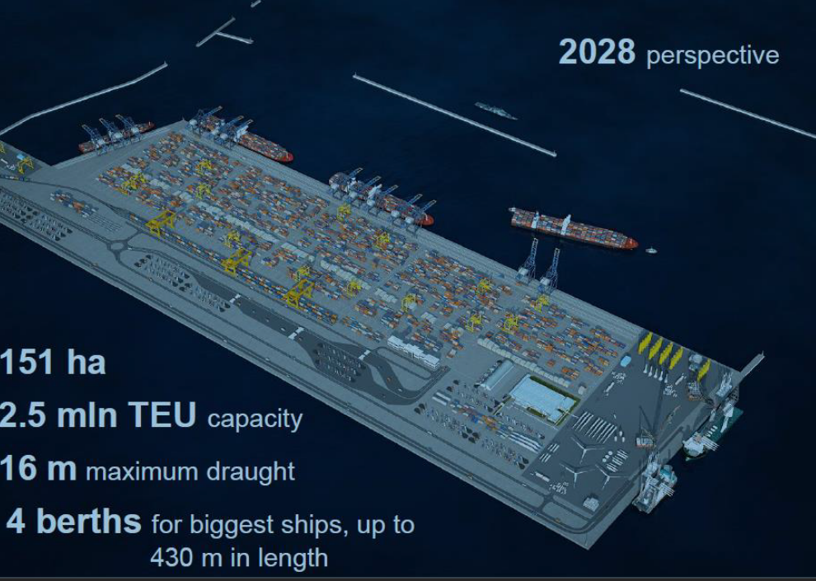
Ports as hubs for renewable energy
Locations of OWF projects in Polish economic zone
Visualization of the Outer Port in Gdynia
—
Source: RenewableUK

Slide 15
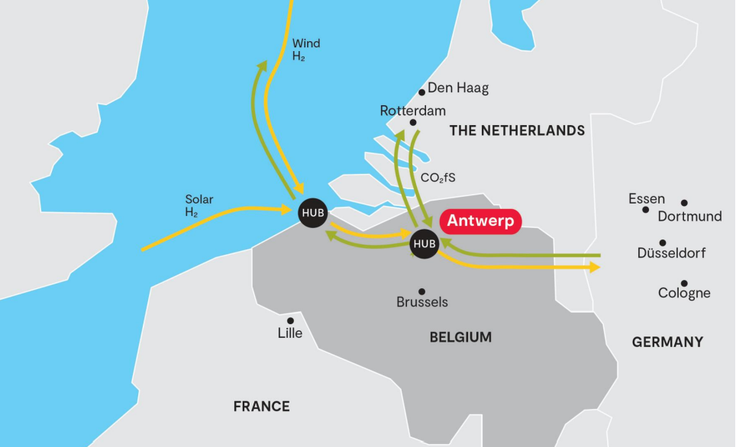
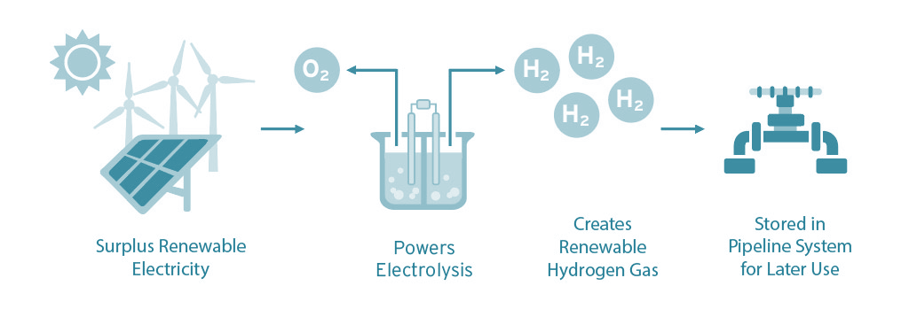
Ports as hubs for renewable energy
Antwerp has signed a memorandum of understanding with the Chilean government at the COP26 climate conference in Glasgow, to speed up green hydrogen flows between South America and Western Europe. “This cooperation will remove the last barriers and gaps in the run-up to the effective start-up of green production, the establishment of the logistics chain between the continents, and the logistics in the Belgian seaports and their hinterland”
The process of transforming renewable solar/wind energy to hydrogen
—
Source: Socalgas, Port of Antwerp

Slide 16
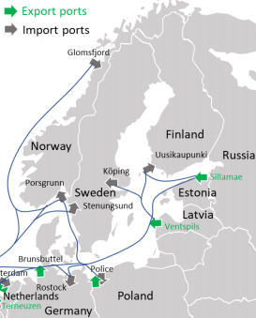
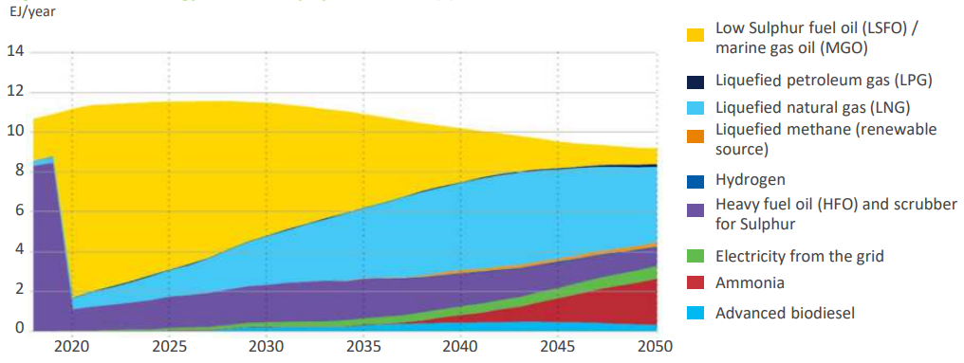
New fuels for ships – infrastructure in ports
Maritime energy demand and projected fuel mix to 2050
Export and import ammonia terminals in the Baltic Sea region
—
Source: DNV & Eurelectric, Alfa Laval

Slide 17
Conclusions
Future energy mix:
Much lower demand for fossil fuels
Energy transportation – down
Less energy cargo in ports
Ports (opportunities):
Logistics of new fuels (hub role)
Wind energy – value chain
New fuels for shipping
—

Slide 18
Will climate policy affect the port sector?
Yes, it will.
Ports:
Need to adjust to new energy mix
Response to new energy development
Seek for new revenues/new business model
—

Slide 19
Go Baltic!
Follow us:
Twitter
LinkedIn
e-shots
website
events.
—
Bogdan Ołdakowski
Secretary General
Baltic Ports Organization
bpo.sg@actiaforum.pl
www.bpoports.com

